Slide 1
Welcome to Mrs. O-C’s Classroom
Grab a blank sheet of paper on the front or back table.
Write your name and class period in the top right corner
With thanks to Mr. McAllister at St. Charles for the original presentation
Notes:
Everybody makes mistakes. When you’re working with technology: learn how to find and fix errors and problems.

Slide 2
Week 1 is about getting to know:
each other
Likes / dislikes
Strengths / skills / goals
what the class is about
Content and practices
what the class rules are
A bit each day
what you want to know and do with computers and technology
The 1st week

Slide 4
2 basic rules
Have respect
Be on task
Give 2 examples of what it means to have respect.
Give 2 examples of what it means to be on task

Slide 5
I take attendance.
I fill out tardy forms.

Slide 6
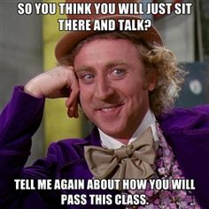
You are going to be doing work in this class.
I have never had a student fail who has completed all assignments ON TIME.

Slide 7
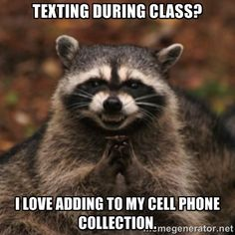
It is a COUNTY as well as a SCHOOL RULE, no electronic devices during the school day except times that teachers ask you to use them.
I will tell you when these times are, don’t abuse these occasions.

Slide 8
Who is standing in front of you……
My name is Mrs. O’Grady-Cunniff (Mrs. O-C)
I teach Computer Science and Technology classes
Tuesday’s PRIDE time
Coding Outreach Club
Computer Bowl competition club
3. What PRIDE time activities are you interested in? (or would you create if you could)

Slide 9
About me
4. List at least 2 things you really enjoy doing.
5. Describe one thing you would like to change or improve in the world.
I have a life outside of school……
I like to hike, bike, and read.
My passion is to advocate for computer science for all

Slide 10
About me
6. How many schools have you attended?
7. Write down the last school you went to before here and where it is.
I’m not from Maryland
We moved a lot
I’ve attended 18 different schools
Most recently my Bachelors is in CS from the University of Delaware, my Masters is in ed tech from Wilkes University

Slide 11
Check the website mrs-o-c.com if you miss a class.
Ask classmates for missed work.
Make sure you hand your excused pass to me.
We try to do something valuable each day but since you were absent we just did coloring pages.
http://images.parents.mdpcdn.com/sites/parents.com/files/styles/width_360/public/images/skyword/kids%20coloring%20with%20crayons.jpg

Slide 12
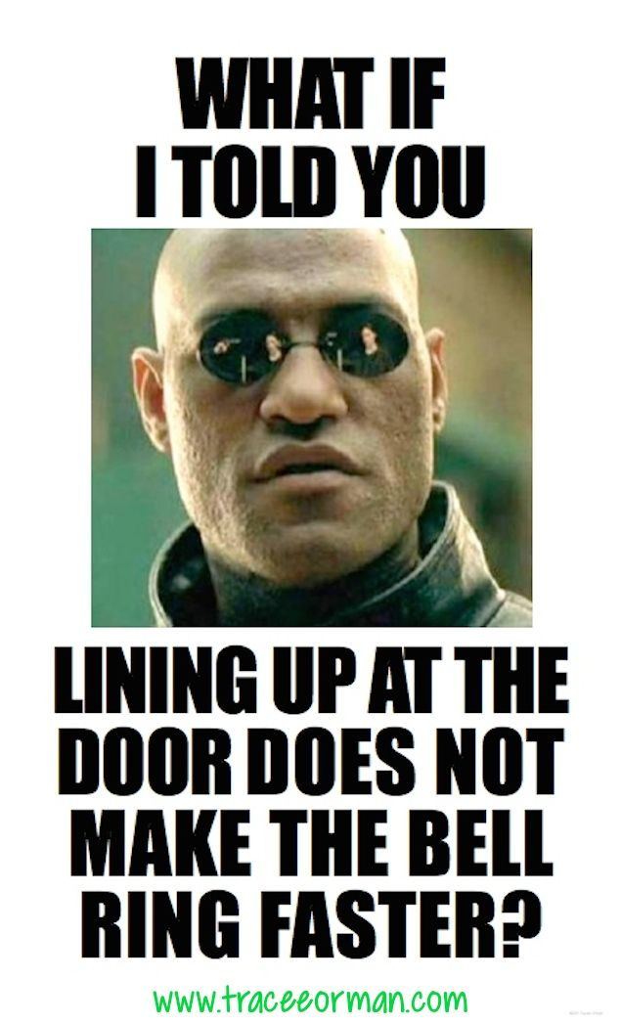
At the end of the class period
Stay in your seats
Dismissed by the teacher

Slide 13
Class Expectations- When entering the classroom
Should be doing
Shouldn’t be doing
Going to table and grabbing binder/notebook
Handing in homework to your class’ hand in folder
Getting work that is graded from Handed back class folder
Reading board for instructions
Joking around, talking with your friends about the killer move to win the game last night, etc
Copying homework
Eating
Standing around

